Slide 1
Distinct Value Sketches
Pravin Y Pawar

Slide 2
Counting Distinct Elements
Easy task in non streaming world but not that easy in streaming world
Memory constraints are there so can not keep all stream data in memory
Question to be answered :
How many distinct value were shown in last hour? {cardinality estimation}
Approach1 :
Use hash table that can hold the data value and has search capabilities
But still there will be limitations on number of data values that can be stored in hash table
Use bit pattern based data structure for the same

Slide 3
Bit pattern based algorithm
Based on the observation patterns of bits that occur at the beginning of binary value of each element of stream
Mostly using the leading zeros in the binary representation of hash of stream element – cardinality is determined
Example, HyperLogLog , HyperLogLog++

Slide 4
HyperLogLog
Working
Step1 – Identify a unique ID for the data value
Step2 – Pass the ID through a hash function , it will result into a hashed value
Step3 – Hashed value is converted into a binary representation
Step4 – Need to determine the place which needs to be updated and with what value.
Take the least 6 significant digits of binary number and convert it to a decimal value. That gives you the position where value needs to be updated
Count the number of leading zeros in the binary number , add one to it and use that number as a value to be stored in the position identified earlier
Step5- Determine the distinct counts by taking the harmonic mean of all register values.
Reference : Harmonic Mean

Slide 5
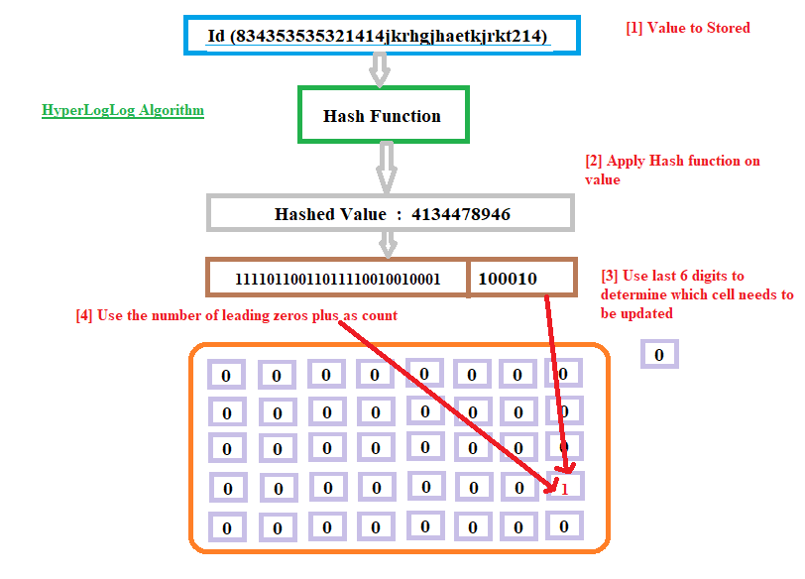
HyperLogLog (2)

Slide 6
Thank You!
In our next session: The Count-Min Sketch

